Slide 1
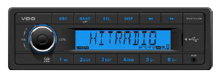
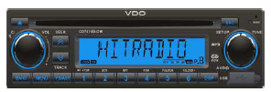
I CVAM VE VDO Audio
Radios
Customer Group
Distribution and small to medium O.E. manufacturers.
Benefits and Features
All models feature AUX & USB input and memory backup
Bluetooth models available with remote microphone
Retail friendly radio & speaker kits available
Technical Data
Available with AM/FM (and DAB/DAB+/DMB for Europe/Asia), USB (MP3/WMA), AUX, CD and Bluetooth
Standard 1 DIN size
12V & 24V available models
4x40W output (12V) and 4X15W output (24V)
Variants
Available in Continental branding with orange LCD display, and VDO branding with blue LCD display.
Availability:
In Stock, Allentown PA
– A trademark of the Continental Corporation
Product Manager
Name: Nathan Killen
E-Mail: nathan.killeen @continental-corporation.com

Slide 2
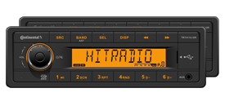
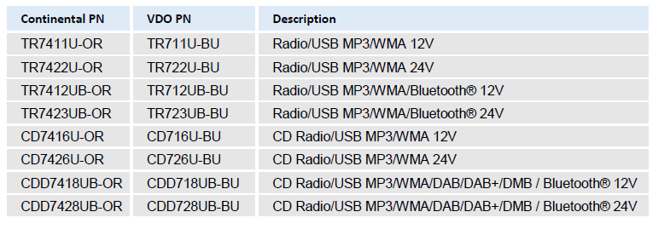
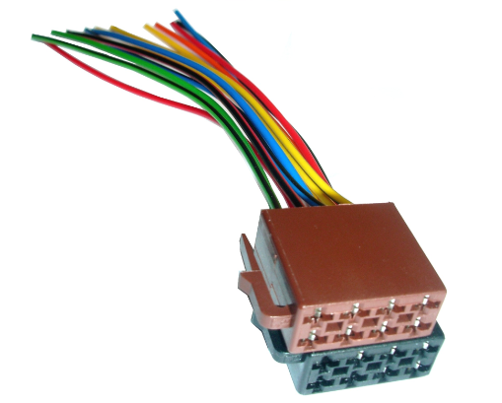
I CVAM VE VDO Audio
Marketing: Expanded Radio program now offers extremely cost effective units, available in both VDO and Continental branding along with speakers, antennas and marine splash cover
Part Numbers
Radios
Availability:
In stock, Allentown PA
For OE installation radios require harness/pigtail CA0504U-LS
– A trademark of the Continental Corporation
Product Manager
Name: Nathan Killen
E-Mail: nathan.killeen @continental-corporation.com

